Slide 1
Managing Neurodiversity in the Workplace
– Key Legal & Practical Considerations
11 September 2025
Mark Landon
Partner
Weightmans LLP

Slide 2
Agenda
What is ‘neurodiversity’?
Supporting neurodiversity – ethical & operational significance
Legal protection – unfair dismissal and disability discrimination
Practical steps to provide support / common workplace challenges
Q&A
Close

Slide 3
What is neurodiversity?
‘Neurodiversity’ (or neurological diversity) refers to the different ways in which a person’s brain processes information: every person’s brain is unique, and no two people will view the world (or the workplace) in the same way
People might have a ‘neurotypical’ cognitive profile or a ‘neurodivergent’ one…
Neurodivergent I Neurotypical range I Neurodivergent
people whose way of I people whose way of I people whose way of
communicating and/or I communicating and/or I communicating and/or
thinking differs from I thinking conforms to the I thinking differs from
the ‘norm’ I accepted societal ‘norm’ I the ‘norm’
…There is nothing ‘right’ or ‘wrong’ about having either cognitive profile…it’s estimated that between 1 in 5
and 1 in 7 people in the UK are likely to be neurodivergent

Slide 4
What is neurodiversity?
Neurodivergent conditions fall into three categories:
  Applied neurodivergence
  Clinical neurodivergence
  Acquired neurodivergence
Some neurodivergent conditions (e.g. dyslexia) can impact on an individual’s ability to learn and some people prefer to refer to these as a ‘learning difference’
Whilst people with neurodivergent conditions often have skills and attributes that are not normally associated with neurotypical people, some face workplace challenges that neurotypical people generally do not…which is why they need understanding and support from both management and colleagues

Slide 5
Supporting neurodiversity – ethical & commercial significance
Supporting neurodiversity in the workplace has a positive ethical, commercial and operational impact as it:
  Maximises the talent pool in recruitment and promotion, and facilitates staff retention
  Enriches the workplace, broadens the skillsets within an organisation and often brings a useful different perspective…thereby enhancing an organisation’s quality of service
  Strengthens an organisation’s internal and external reputation; and
  Saves costs (reduced staff turnover / less need for managerial intervention / lower risk of claims)

Slide 6
Neurodiversity – legal protection
People with neurodivergent conditions and learning differences sometimes struggle with certain aspects of working life, e.g.:
  Where an individual’s neurodivergent condition affects their communication skills then this might impact on a recruitment or promotion application
  Where an individual struggles to process written information then this might affect their day-to-day performance and, in turn, result in a poor appraisal or the non-receipt of a bonus
  There may be friction in the workplace due to a lack of understanding amongst colleagues about the impact of a person’s neurodivergent condition on their inter-personal skills
Whilst it makes ethical, commercial & operational sense to be supportive, an employer may also face legal consequences if it fails to do so…

Slide 7
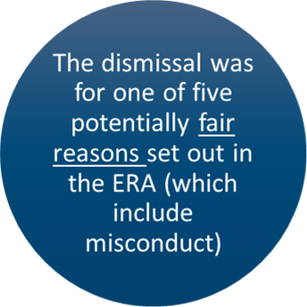
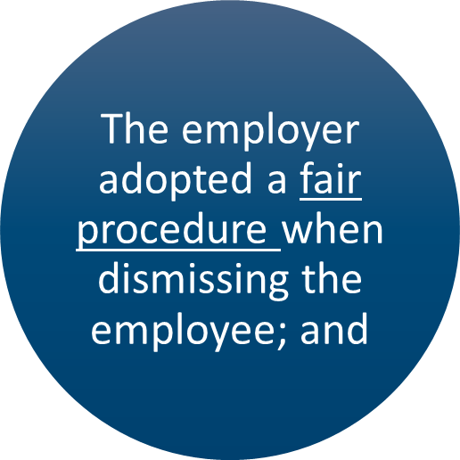
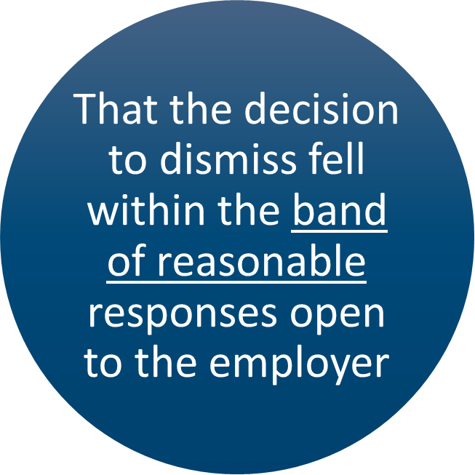
Neurodiversity – legal protection
- Unfair dismissal protection:
  If an employee is dismissed for a reason linked to their neurodivergent condition or learning difference then they may claim unfair dismissal
  In most unfair dismissal cases an Employment Tribunal will focus on the fairness of the procedure that was adopted…

Slide 8
Neurodiversity – legal protection
- Unfair dismissal protection (cont.): a fair procedure will typically include…
  Following a written and accessible procedure (with adjustments being made to it, where necessary)
  Fully investigating the reason(s) for the employee’s poor performance, attendance or conduct, including seeking timely input from any relevant expert such as an OH clinician
  Giving appropriate consideration to any reasonable workplace adjustments that might address the employer’s concerns and thereby avoid the employee’s dismissal
  Giving appropriate warnings before considering the employee’s dismissal
  Notifying the employee when they are at risk of dismissal and providing them with the relevant (accessible) evidence so that they can put forward their case before any decision is reached
  Carefully considering any alternatives to dismissing the employee (e.g. redeployment to a more suitable role); and
  Providing an opportunity to appeal any decision

Slide 9
Neurodiversity – legal protection
- Disability discrimination:
  Discrimination claims involve alleged breaches of The Equality Act 2010
    There are nine protected characteristics, including disability (and 24% of the UK working population have a disability)
    Some people may raise concerns based upon more than one protected characteristic, e.g. disability & age
    The Equality Act covers a wide range of people in the workplace
  In order to be protected against disability discrimination, a neurodivergent condition or learning difference would need to fulfil the statutory definition of a ‘disability’, i.e. it would need to comprise a physical or mental impairment which has a substantial and long-term adverse effect on normal day-to-day activities…
  …and employers need to be aware that many disabilities are not visible/obvious

Slide 10
Neurodiversity – legal protection
- Disability discrimination (cont.):
  Direct discrimination )
  Indirect discrimination ) (These forms of protection apply to
  Harassment ) all nine protected characteristics)
  Victimisation )
  There are three additional forms of protection which are specific to people with a disability, including:
    Discrimination arising from disability; and
    The duty on employers to make reasonable adjustments (the cornerstone of disability protection)

Slide 11
Neurodiversity – legal protection
- Disability discrimination (cont.):
  The ‘disability trinity’:
  Indirect disability Discrimination arising
  discrimination from disability
  (justification defence) (justification defence)
  Employer’s duty to make reasonable adjustments

Slide 12
Neurodiversity – legal protection
- Disability discrimination (cont.):
  The duty to make reasonable adjustments comprises three elements…
      Where a provision, criterion or practice applied by or on behalf of the employer; or
      Where a physical feature of the employer’s premises; or
      Where the non-provision of an auxiliary aid or service…
  puts a disabled person at a substantial disadvantage in comparison with non-disabled people, then the
  employer must make one or more reasonable adjustments to prevent that disadvantage

Slide 13
Neurodiversity – creating a supportive working environment
General practical steps:
  Clear leadership
  Regularly survey the workforce to gain an accurate picture of staff needs
  Create a staff neurodiversity review panel
  Establish & maintain neurodiversity policy & guidance
  Establish internal support groups and neurodiversity ‘champions’
  Raise awareness/provide training to the workforce generally and where specifically helpful
  Proactively provide & maintain a record of workplace adjustments

Slide 14
Neurodiversity – creating a supportive working environment
Detailed practical steps:
  Workplace-related neuro-inclusive good practices can be divided into three interacting components:
    Place – the physical working environment, including the workspace and the equipment within it
    Processes – the internal processes and systems, including HR practices, that govern the way in which people are managed and looked after at work
    People – the way individual employees treat one another, contributing to the workplace culture more generally
  However, it remains the case that the experiences and associated strengths and needs of each neurodivergent person are unique and neuro-inclusive practices can never be “one size fits all”

Slide 15
Neurodiversity – common workplace challenges
Recruitment and promotion exercises
Poor performance
Poor attendance
Misconduct

Slide 16

General Q&A

Slide 17

Contact details
Partner, Mark Landon
mark.landon@weightmans.com

